Slide 1
A Reflective Design Case of Practical Micro-Ethics in Learning Analytics
Simon Knight^{ab*}, Antonette Shibaniª, Simon Buckingham Shum^{bc}
^{(manuscript in submission)}

Slide 2

What should entry requirements to uni be?
Vs
How much should we devote to students who aren’t suceeding?
Notes:
https://aiethicslab.com/big-picture/

Slide 3
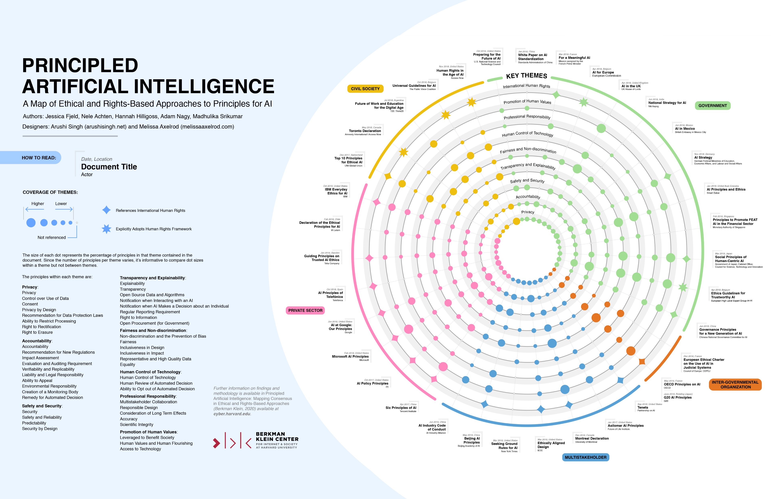
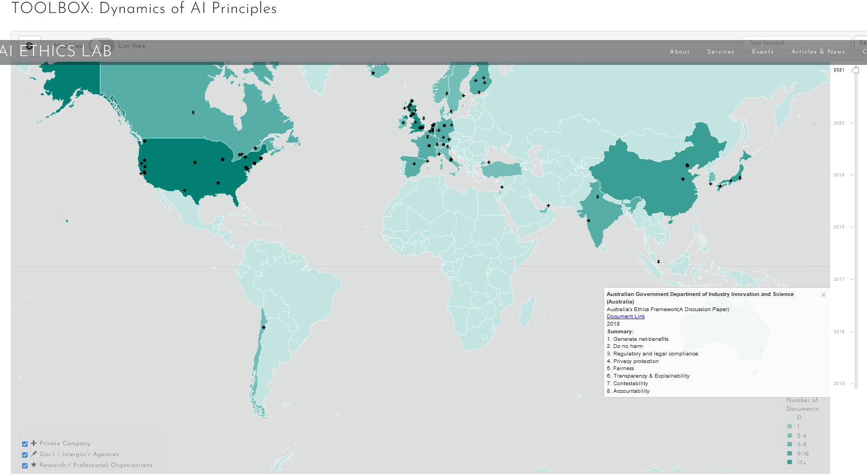
Principles proliferate
Growing recognition of ethics
But, how do we navigate?
We need to understand how people navigate and learn to navigate ethical decision making
Notes:
https://wilkins.law.harvard.edu/misc/PrincipledAI_FinalGraphic.jpg

Slide 4


Despite increased attention:
The focus has been procedural ethics, principles not practice
Obvious cases of ethical failure have been central
https://www.chronicle.com/article/an-appalling-breach-of-faith-at-mount-st-marys/
Notes:
Casees: “by Bezuidenhour and Ratti (2021), these cases tend to (1) be clear in their ethical direction (i.e., uncontroversially controversies, or clearly demonstrating maleficence) and (2) coarse-grained (i.e., about a particular feature and incident), such as the case of a university president saying: ‘drown the bunnies…put a Glock to their heads’, “

Slide 5
EdTech builders, and teachers navigate these issues every day
What cases can they look to?
Ethics-in-action – From procedural → practice oriented
Sensitivity or attuntement to ethically important moments
“in performing design and research, ‘we show ourselves to be ethical [orig: knowledgeable] in a special way’ (p. 49) —our ethics is tacitly in action, deeply folded into ‘recognitions, judgements and skilful performances’ (ibid, p. 50).” (Frauenberger et al., 2017, p. 11).
Notes:
, There have therefore been calls for a more textured approach to ethics (Gray & Boling, 2016; Holmes et al., 2021; Kitto & Knight, 2019). That is, an ethics that both recognises the micro-interactional design contexts in which teachers, students, and technologists make decisions that are imbued with ethical character, and that recognises the macro-situational context in which technologies act and interact, producing both hard (i.e. direct) and soft (i.e., indirect) impacts (Swierstra, 2015). In research ethics, these calls indicate a greater articulation of the ethical concepts used (Beauchemin et al., 2021). These calls reflect a shift from formal or procedural ethics, towards a situational or ethics-in-practice approach (Guillemin & Gillam, 2004). This latter approach recognises both that the application of procedural ethics is a practice in its own right (applied ethics), but moreover a recognition that ethics are imbued in our action and design in ways not captured by procedural approaches, and the significance of sharing ethical cases and principles beyond failures of ethics. This shift is paralleled in moves towards ‘micro-ethics’, with recent work to integrate such approaches into data science education to connect, “the ‘big picture’ of digital/data ethics to the routines of daily practice” (Bezuidenhout & Ratti, 2021, p. 939).
However, despite this popular awareness and set of resources, there are few practical examples or cases that provide close ethical readings of choices made in the design, development, and delivery of educational technologies. For example, of the 3,243 citations to Guillemin and Gillam’s (2004) seminal paper on ‘ethically important moments’ in qualitative research, few of these papers have edtech as the central focus. As such, relatively little is known about the micro-ethical (Guillemin & Gillam, 2004) decision making in the design, development, and implementation of learning technologies.
At the time of writing, 67 refer to “educational technology”. Similarly, a simple Google Scholar search for “educational technology” AND “situational ethics”, returns only 154 papers in total.
means a sensitivity or attunement to “ethically important moments”, and a responsiveness to these “difficult, often subtle, and usually unpredictable situations that arise in the practice of doing research” (Guillemin & Gillam, 2004, p. 262). These include features such as how to navigate participant disclosures, judgements made in pursuing lines of questioning that may be uncomfortable, and so on. Significantly, guidelines and principles cannot ‘solve’ the issue: “Research ethics committees cannot help when you are in the field and difficult, unexpected situations arise, when you are forced to make immediate decisions about ethical concerns” (Guillemin & Gillam, 2004, p. 273). Cases, though, provide a valuable tool for sharing and thinking about developing and applying ethical practice (Johansen & Frederiksen, 2021).

Slide 6
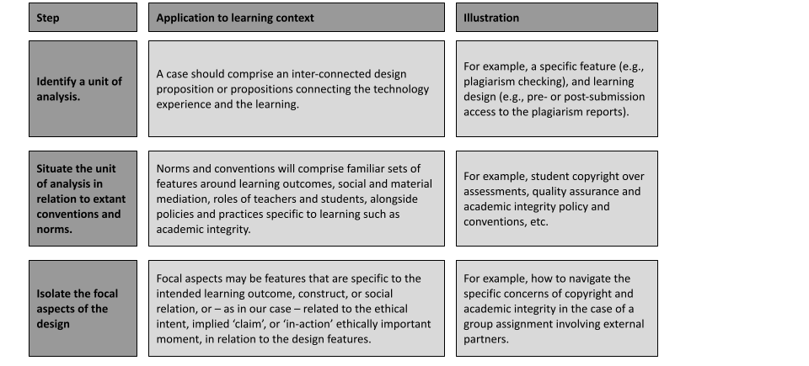
Q: How can we capture this reflection on action?
A: We developed a reflective design case study approach

Slide 7
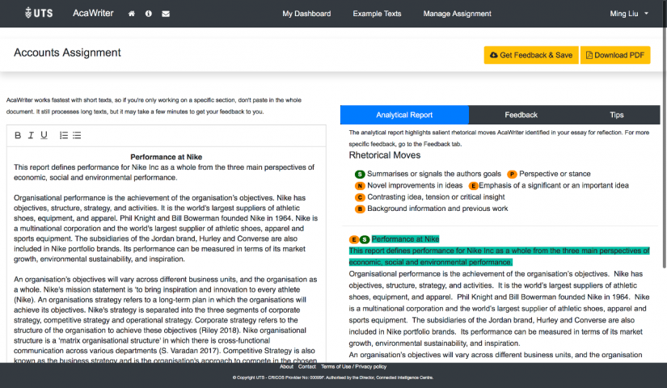
UNIT OF ANALYSIS

Slide 8
SITUATE WITH NORMS AND CONVENTIONS
HREC: Belmont principles (autonomy, beneficence, justice) + merit and integrity
Variety of university policies
Range of cases (lots of bunnies)
Value Sensitive Design (Friedman)
Undertheorises tech use for learning
Fails to recognise tradeoffs in benefits vs harms (treating them as distinct)
No conceptual resource for ethics-in-action
.Ethical Matrix (Tangen)
Research Ethics Taxonomy (Beachemin, Sieber)
All provide useful resource.
Notes:
growing approach in technology design is that of ‘value sensitive design’ (Friedman, 1996; Friedman et al., 2002), intended to provide a design model that recognises the ways in which our technologies are imbued with values, that impact stakeholder groups in different ways. Briefly, the approach takes a technology, identifies its stakeholders, and benefits and harms for each groups, which are mapped onto values, and analysed for key issues and conflicts in these values, to feed into the design structures. However, while the approach has received recent attention, becoming part of the conventions in the field (see, e.g., Chen & Zhu, 2019), it does not offer an adequate model in our case for three reasons: (1) it undertheorizes the technology-use nexus in the context of educational technologies, designed for particular pedagogic contexts or tasks; (2) the analysis of benefits and harms as distinct does not recognise their inseparable nature, and the tradeoffs we make in prioritising one over another; (3) it does not provide conceptual resource for the ethics-in-action or run-time design decisions made in learning contexts, and the kind of close analysis of interest here (for further critique, see Reijers & Gordijn, 2019).
Goodyear, run-time design

Slide 9
From Tangen, R. (2014). Balancing Ethics and Quality in Educational Research—The Ethical Matrix Method. Scandinavian Journal of Educational Research, 58(6), 678–694. https://doi.org/10.1080/00313831.2013.821089 Table 3 of 3
Table 3 Ethical Matrix—Extended Version: Educational Research and Development
Ethical |  | Values
Domains | Stakeholders | Well-being | Autonomy | Justice
A quality of the research process and results | The research community | Acceptable working conditions. Scientific integrity. | Freedom of research. Scientific integrity; independence of authorities and principals. Innovativeness. | Equitable funding systems. Objective and professional publishing agencies. Equal opportunities of accessing relevant political forums.
Beneficence & Autonomy | Research participants | Protection from harm; privacy; anonymity | Informed consent. Being heard—participant voice | Equal opportunities of being listened to and consulted
C – relevance and value | Users of educational services (children, parents) | Quality of (pre-) school. Adapted educational provision; positive learning, participation, inclusion | Agency Their voices being heard. Participation. Relevant choices. | Equal educational opportunities—School for All. Pupil-adapted educational provision.
B/C | Students in teacher training and special education training | Quality of education—integrated theory and practice. Quality of student life. | Their voices being heard; participation. Relevant choices of education. | Equal opportunities for research and practice- based education of high quality.
C | Practitioners | Acceptable working conditions. Professional integrity. Quality of working life. | Having a voice in defining research problems. Access to knowledge and competence development. R&D promoting agency and reflective practice. | Having a voice in defining research problems; Equal opportunities for competence development. User-friendly dissemination of research.
C | Policy makers | R&D useful for planning and promoting quality of education and quality of life for pupils and practitioners. | R&D promoting participation and democracy within and through education. Dialogue with researchers on research problems and findings. | R&D promoting equal educational opportunities and adapted educational provision.
Notes:
Additional resources can be found in artefacts such as the ‘Ethical Matrix’ (Tangen, 2014) and research ethics taxonomy (Beauchemin et al., 2021; Sieber, 2004). The former of these (Ethical Matrix) analyses the Belmont principles with respect to different stakeholder groups: Research community; Research participants; Users of educational services (children/pupils, parents); Students in teacher training and special education training; Practitioners; Policy makers.

Slide 10
Communication Between Researcher and Participant | Acquisition and Use of Data | External Influences on Research | Risk and Benefit | Theory, Method, and Design
Informed consent | Privacy | Government regulations | Risk, wrong, and harm | Epistemology
Deception | Confidentiality | Institutional review boards (IRBs) | Benefit and promise of research | Validity
Cultural sensitivity | Uses of data, obligation to publish, data sharing, and dissemination | Questionable, taboo, and controversial topics of research | Risk–benefit assessment | Modeling
Relationships as a source of data |  | Scientific integrity and responsibility |  | Equitable treatment of participants
 |  | Ethics and politics |  | Language and meaning
Table 7 Sieber’s taxonomy of research ethics topics (Sieber, 2004: 408–412)
From: Conceptualising Ethical Issues in the Conduct of Research: Results from a Critical and Systematic Literature Review
Notes:
The latter (taxonomy of research ethics topics) analyses the principles (and their instantiation into polices such as informed consent) across components of a research programme (Researcher-participant communication; acquisition and use of data; external influences on research; risk and benefit; theory, method, and design).

Slide 11

Breaking down focal aspects along the design phases
Notes:
Shibani to explain the focal aspects/ practical examples from our case
The focus is on capturing ethically important moments/ micro-ethics/ dilemmas that often go unreported

Slide 12
Inception and design phase: How do we Design for Impact?
What stakes are appropriate?
What does this imply
we value?
Are there barriers to using the feedback?
Equitable feedback for users with spelling or grammar errors
‘Quick fix’ summative approaches and direct insight to instructors
Low-level features such as spelling and grammar
Designing automated feedback for students to interpret and act on
Over-emphasized features, opportunity costs for other areas
Rhetorical moves salient to disciplinary writing contexts
Student (not teacher) oriented tool, for formative feedback on writing
Feedback to augment existing assessment structure
Target features with clear “the machine doesn’t understand your writing” messaging
Rollout to students with instructor involvement
Not including grammar and spelling checking for feedback
Flag the limitations and direct to already existing tools
Notes:
Some of these might look like minor decisions to make, but they might have implications on students writing and their ability to engage with feedback
the overarching concern of opportunity costs: If we introduce this change, what other activities are we preventing or downgrading?
Stakes - What role should automated tools play in formative or summative assessment?
Interpretation affords potential learning
potential to over-emphasise low-level feedback (a common issue in writing feedback), and introducing opportunity cost for both development resource, and student focus
Spell checking may seem like an ordinary example of a non-ethical feature and serves as a good example of micro-ethics in practice

Slide 13
Development and Evaluation Phase: What is this data for?
Can we use that data for this?
What stakes are appropriate here?
How can we evaluate in practice?
Maximize algorithmic validity and interrater reliability
Data might contain identifiers. Is consent to privacy policy sufficient?
Existing classroom activities, no impact on student evaluations
Introducing a feedback tool with unknown benefits
Using de-identified legacy data for tool development and evaluation
Assess relevance and usefulness for practice
Seek consent waiver HREC with instructor gatekeepers to the data
Acknowledge risks and ensure de-identification of data
Increase integration into the core learning design with increasingly higher quality evidence of impact
Draw on the data available, and existing well-established tasks, to develop a suitable evaluation model aligned with practice
Notes:
No existing corpora available

Slide 14
Development and Evaluation Phase: Power Dynamics at the Research-Practice Nexus
How do we navigate boundaries of researcher, participant, and student?
How do we balance fidelity and flexibility?
Is this research or quality improvement?
Participants received appropriate information, and opt-in consent where specific research tasks were undertaken following research principles
Practitioner participants invited as co-researchers and engaged as participants by mutual agreement where appropriate
Flexibility in delivery by engaging tutors rather than strict research designs emphasizing fidelity
Notes:
No existing corpora available

Slide 15
Implementation and Evaluation Phase: : Is it ready to use?
How can we scale our evaluation?
What do we mean by scale?
When is it ready?
Evaluation of implementations to show that the tool fostered supportive learning tasks, and supported desired changes in student writing
Evaluation model designed to build over time, augmenting existing classroom practices
Focus on alignment of learning impact with intended learning outcomes rather than ‘numbers of users’
Notes:
No existing corpora available

Slide 16
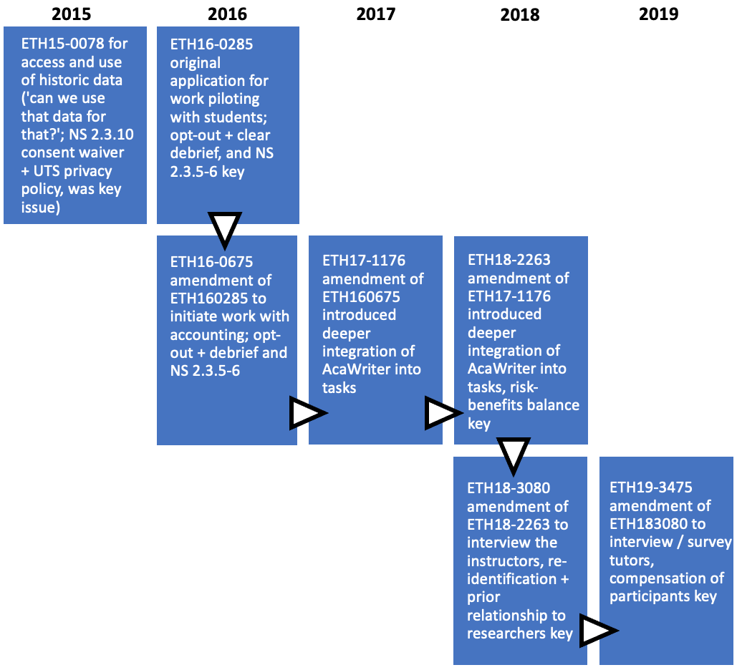

Slide 17
AI [research] ethics: What are we talking and doing about?
Simon Knight, Linda Przhedetsky, Antonette Shibani, Nicole Vincent
^{(manuscript in preparation)}
Notes:
Ok so we just explored material resources, now we’re going to look at what others do

Slide 18
HREC applications inscribe ethical concerns and assumptions.
They are a material lens, providing a view onto the material resources that are drawn on in ethical practice.

Slide 19
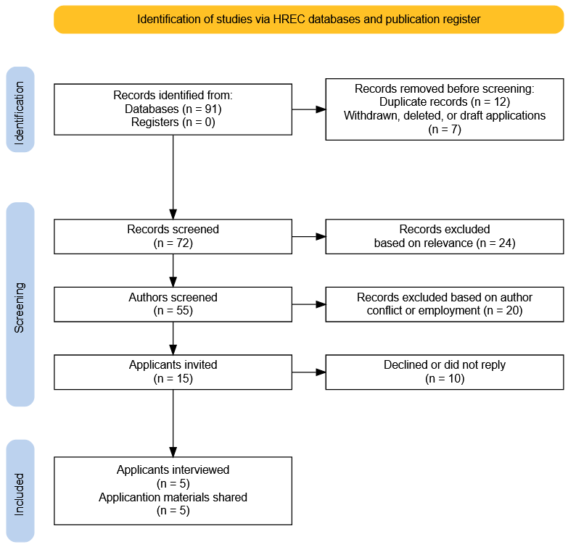
Additional applications (n = 4) have been identified since.

Slide 20



Resources drawn on
Interviews
+
HREC materials
Literature
APPs
Bostrom, N. and E. Yudkowsky, The ethics of artificial intelligence. The Cambridge Handbook of Artificial Intelligence, 2014
Elements of AI
AI Ethics Framework
The HREC materials themselves
Privacy statements
Internal guidance
Legislation
x5

Slide 21

Next phase
UTS Publication search for ‘AI’ themes and ethics
Search so far indicates 1000s of articles (with UTS affiliation in any authorship position, broad search terms across whole document)
Captures further inscribed ethics.
And non-HREC research with impact on humans

Slide 22
Headlines so far
Despite the clear interest in AI ethics, and challenges such as secondary use of data, we found relatively few applications
In the interviews and materials analysed, the specific ethical implications of technologies both with immediate impact and secondary or soft impacts, were not a key feature
the interviews probed these
The material was HREC material
Tired trope:…Further research is needed into how researchers navigate, and learn to navigate AI ethics

Slide 23
Thanks!

